Slide 1
EI (Engagement and Impact) Guide for Staff The University of Divinity
For further information please see:
https://www.arc.gov.au/engagement-and-impact-assessment
https://www.arc.gov.au/news-publications/media/presentations/standard-excellence-research-australia-era-and-engagement-and-impact-ei-2018-outcomes
https://www.arc.gov.au/engagement-and-impact-assessment/ei-key-documents

Slide 2
What is EI?
The Engagement and Impact Assessment is Australia’s national research engagement evaluation framework.
EI assesses how well researchers are engaging with end-users of research, and shows how universities are translating their research into economic, social, environmental, cultural and other impacts.
EI aims to encourage greater collaboration between universities and research end users, such as industry.

Slide 3
What is EI?
EI is a companion exercise to Excellence in Research for Australia (ERA) and is assessed under the same FoR codes.
Engagement and Impact activities must be based on our peer-reviewed research submitted for ERA
The next round of ERA will take place in 2024.

Slide 4
What is EI?
Engagement and Impact helps us measure how well we are achieving the University’s Vision statement.
Our Vision
Together we empower our learning community to address the issues of the contemporary world through critical engagement with Christian theological traditions.
Our Mission
We fulfil our vision through:
excellence in learning, teaching, and research;
growth of our resources and capacity; and
engagement with the churches and community in Australia and internationally.

Slide 5
Evaluation by expert review
In EI, assessment panels comprise researchers and research end-users.
There are three areas that are rated by the panel.
Engagement
Impact
Approach to Impact

Slide 6
Definition of Engagement and Impact
Engagement
Research engagement is the interaction between researchers and research end-users outside of academia for the mutually beneficial transfer of knowledge, technologies, methods or resources.
In other words, engagement is about projects where everyone wins – researchers and the eventual end-users of our research.
In the health sciences this might look like working with a private laboratory to invent a new technology. In our disciplines, it will usually be examples of co-operative projects with churches and communities.

Slide 7
Definition of Engagement and Impact
Impact
Research impact is the contribution that research makes to the economy, society, environment or culture, beyond the contribution to academic research.
Impact flows one way. It is our gift to our world: something we produce at the University, which benefits others.
Impact is not about research outcomes, but the positive effects beyond them.

Slide 8
Definition of Research end-user
A research end-user is an individual, community or organisation external to academia that will directly use or directly benefit from the output, outcome or result of the research.
Examples of research end-users include
governments, businesses, non-governmental organisations, communities, and community organisations.
Specific exclusions of research end-users are:
publicly funded research organisations (CSIRO, AIMS, ANSTO, NMI, DSTG, etc.)
other higher education providers (including international universities) and their affiliates

Slide 9
Engagement rating scale
Panels assess research engagement using a three-point scale.
Disciplines are defined as two-digit and four-digit Fields of Research (FoRs) codes as identified in the Australian and New Zealand Standard Research Classification.
Units of Assessment (UofA’s) are the ARC’s term for FoR codes for ERA and EI purposes.
Research at the University of Divinity is currently assessed under code 22 (Philosophy and Religious Studies).

Slide 10
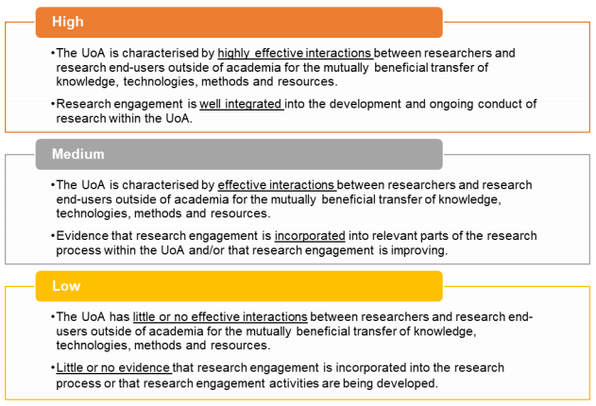
Engagement rating scale
Panels assess research engagement using a three-point scale.

Slide 11
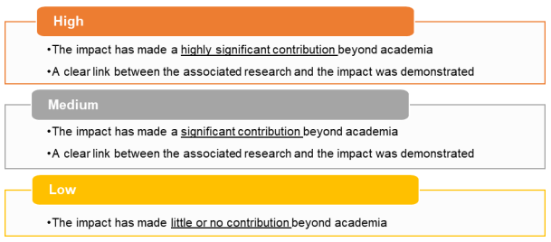
Impact rating scale
Panels assess impact using a three-point scale.

Slide 12
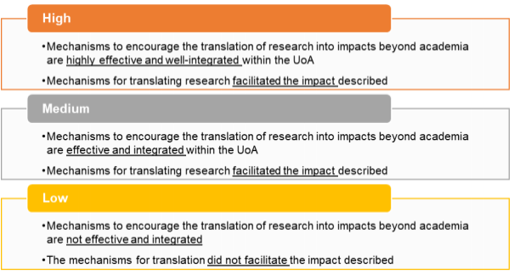
Approach to Impact rating scale
Panels assess approach to impact using a three-point scale.

Slide 13
Previous Results
This table shows the results of the EI 2018 for institutions who were evaluated for FoR code 22.
The University of Divinity scored a rating of Low for all categories.
Institution | Engagement | Impact | Approach To Impact
ACU - Australian Catholic University | High | Medium | Medium
ANU - The Australian National University | High | High | Medium
CSU - Charles Sturt University | Medium | Medium | Low
DIV - University of Divinity | Low | Low | Low
DKN - Deakin University | High | Medium | Medium
FLN - The Flinders University of South Australia | Medium | Low | Low
MEL - The University of Melbourne | Medium | High | Medium
MON - Monash University | High | High | High
MQU - Macquarie University | High | High | High
MUR - Murdoch University | Low | Low | Low
NDA - The University of Notre Dame Australia | Medium | Low | Low
NEW - The University of Newcastle | Low | Medium | Medium
NSW - The University of New South Wales | Medium | High | High
QLD - The University of Queensland | Medium | Medium | Medium
SYD - The University of Sydney | Medium | Medium | Low
TAS - University of Tasmania | Medium | Medium | Low
WOL - University of Wollongong | Medium | Medium | Low
WSU - Western Sydney University | Medium | High | High

Slide 14
Engagement: Narrative
The University is required to submit an Engagement Narrative. This describes our overall engagement activity, strategies and objectives.
How we engaged with outside parties for the mutual benefit of the institution researchers and research end-users
The purpose of engagement, describing what the University was trying to achieve through the engagement
The duration and extent of the engagement activities.

Slide 15
Engagement: Narrative
In the engagement narrative, we may also include some optional quantitative indicators of engagement.
These can be anything we find relevant. They must be presented as measurable data with a very brief explanation.
For example, the number of attendees at an exhibition co-designed with an outside partner.
A list of possible quantitative indicators is on the following slide.

Slide 16
Engagement: Narrative Optional Quantitative Indicators - examples
Mobility of researchers (i.e. researchers employed or placed outside academia, and/or research end-user employees that are employed or placed within academia)
HDR students in internships/placements
Co-authorship of research outputs with research end-users
Co-funding of research outputs with research end-users
In-kind support from research end-users
Established networks and relationships with research users
Evidence of significant institutional partnerships
Serving on external advisory boards
Consultations with community groups, professional/practice organisations, government bodies
Consultation with/advice to Government
Co-designing and collaborating on performances and exhibitions
Mentoring external research partners
Memoranda of Understanding (MOU)/Agreements

Slide 17
Engagement: Compulsory Indicators
EI has four compulsory indicators of research engagement with research end-users, and they are all simply about income.
The idea is that if we are genuinely engaging with end-users, they will invest money in the University.
This includes things like a church co-funding a research project with community participation.
The specific four indicators, by funding category, are on the following slide.

Slide 18
Engagement: Compulsory Indicators
cash support from research end-users
given as a dollar value and as a proportion of total Higher Education Research Data Collection (HERDC) income for specified HERDC Category 1 and HERDC Categories 2, 3 (i, ii, iii), and 4
total HERDC income per FTE
for specified HERDC Category 1 and Categories 2, 3 (i, ii, iii), and 4
proportion of specified Category 1 grants to all HERDC Category 1 grants
two proportions are provided—one for income ($) provided by the grants and the other for counts of grants
research commercialisation income

Slide 19
Engagement: Compulsory Indicators
Funding must go through the University of Divinity’s accounts to be counted for EI.
It is therefore important to liaise with University administration if you are applying for, or successful in receiving, any research income.

Slide 20
Engagement: Indicator Explanatory Statement
In this brief statement, we explain the link between the financial data in the Indicators, and our engagement with end-users. We need to stress that the engagement was mutually and genuinely beneficial.

Slide 21
Impact: Statement
We submit a statement for Impact assessment, including the following information:
who or what has benefitted from the results of the research (this should identify relevant research end-users, or beneficiaries from industry, the community, government, wider public etc.)
the nature or type of the impact and how the research made a social, economic, cultural and/or environmental impact
the extent of the impact (with specific references to appropriate evidence, such as cost-benefit analysis, quantity of those affected, reported benefits etc.)
the dates and time period in which the impact occurred
a clear link between the impact and the associated research

Slide 22
Impact: Optional Quantitative Indicators
Just as in the engagement narrative, we may also include some optional quantitative indicators of impact.
These can be anything we find relevant. They must be presented as measurable data with a very brief explanation.
For example, the number of public lectures held, and number of attendees.
More examples are on the following slide.

Slide 23
Impact: Optional Quantitative Indicators examples
Established networks and relationships with research users
Book sales
Serving on external advisory boards
Public lectures, seminars, open days, school visits
Presentations to practitioner communities
Connections to cultural institutions, seminars/workshops, internships and engagement with the public
Support for cultural events/institutions—e.g. Writers’ Festivals, Film Festivals, Vivid Sydney, etc.
Co-designing and collaborating on performances and exhibitions
Event participation statistics (public lectures, cultural events, exhibitions, etc.)
Outreach activities (public lectures, policy engagements, media engagements, community events)
Media coverage of exhibitions and new works

Slide 24
Impact: Case Study
The following case study was rated ‘HIGH’ in the 2018 EI.
Western Sydney University (WSU) researchers investigated ways to counter the growth of Islamophobia and associated anti-Muslim racism in Australia.
This research developed four videos (2014) that demonstrated the virtue of bystander anti-racism. These videos reached > 27 million people (appeared on their social media thread), were watched by > 12 million people online... The videos were used in 5 anti-racism training workshops (2014-2016) conducted in schools, community organisations and government departments. The most downloaded video illustrated an incident of a Muslim woman being racially abused on public transport. The Impact Survey found that respondents who watched this video: -were less likely to express anti-Muslim sentiment (44% vs 68.2% in the control group)
This implies that the video reduced Islamophobic sentiment in roughly 3.5 million people (of the 9. 8 million) who had watched the video.

Slide 25
Impact: Case Study
The following case study was rated ‘HIGH’ in the 2018 EI.
The work of University of Melbourne researchers at the Children’s Bioethics Centre (located within Melbourne's Royal Children's Hospital) has led to the creation of guidelines around key ethical issues in paediatric care, furthering the protection of children and informing and facilitating ethical deliberation and consultation between parents and clinicians. Researchers also run a referral service for advising on ethical issues which is widely used globally. Such consultations resolve conflict, facilitate communication, and ease moral distress in health care.

Slide 26
Impact: Case Study
Reconnecting Indigenous Australian communities with heritage objects held in museums and galleries
Reconnecting Indigenous Australian communities with heritage objects held in museums and galleries globally is key to building sustainable communities. The removal of historic objects to museums (nationally and internationally) has made accessing these collections difficult for Indigenous communities from rural and remote areas of Australia. Projects between ANU, industry partners and Indigenous stakeholders have re-connected Indigenous communities to moveable cultural heritage collections stored in metropolitan and municipal museums and galleries globally. They have brought Indigenous Australian communities into direct contact with their cultural artefacts and facilitated new relationships between source communities and museum staff tasked with managing and curating these collections.

Slide 27
Approach to Impact: Statement
We submit a statement for Approach to Impact assessment, including the following information:
support provided by the institution, its faculties, colleges, groups, departments, and/or centres for researchers to affect positive impact
how that support was implemented by the research area
how researchers interacted and engaged with research end-users or beneficiaries
evidence of review of impact processes and outcomes during the period
evidence of how mechanisms of translation were integrated into research practices
human resources policies, initiatives and strategies
financial or other resources made available to facilitate the realisation of the impact

Slide 28
Approach to Impact: Case Study
The following case study was highly rated in the 2018 EI. Click through to view the entire Approach to Impact summary on the ARC website.
“Significant support from WSU, and the development of meaningful, trustworthy and sustained relationships with stakeholders (youth centres, community organisations, religious organisations, health providers and migrant resource centres) was critical to the realisation of impact from this research. WSU ensured a supportive research environment and culture, and funded the organisation of conferences, lectures and research seminars in this field. The School of Social Sciences and Psychology provided financial support for this research through stump funding, and matching funding through its Partnership Grants program. PhD scholarships, a Career Development Fellowship in the ‘Sociology of Islam in Australia,’ facilitated and fuelled industry liaison and demonstrable community impact.”

Slide 29
See more case studies:
https://dataportal.arc.gov.au/EI/Web/Impact/ImpactStudies#/20/1//(for-code%3D%2222%22)

Slide 30
Self Evaluation
Keep a record of your engagement and impact activities. When planning research, you should consider EI outcomes as well as research outcomes.
Date | Engagement or Impact? | Description | Data
2 May 2020 | Impact | Workshop on liturgy for high school students | 28 attendees 4 enrolled in next workshop
May-Aug 2020 | Engagement | New liturgies project with X congregation | 135 participants Co-authored 2 journal articles with parish Priest Published findings in Parish Magazine with circulation of 4400 readers

Slide 31
For more help with ERA and EI, contact
cosborn@divinity.edu.au

